Slide 1
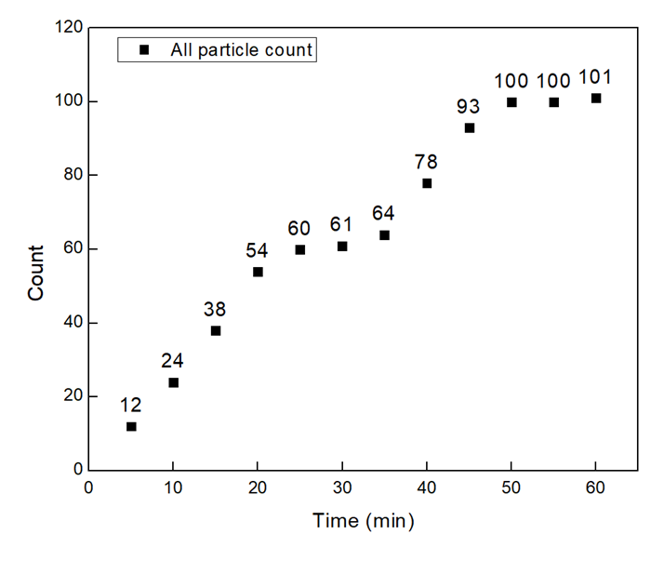
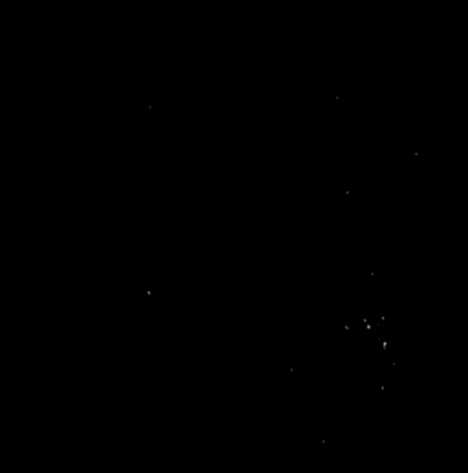
PANORAMA of Plasma Sample 162 (Prediction: Healthy)
Time: 60 min
Count: 101 (Ex: 72 ; Large: 29)
Time: 60 min wash
Count: 16
Based On Count: Before wash count lower CI Healthy (214-263)
After wash count lower CI Healthy (24-34)
Note: 0 % response to miRNA-21
Scale bar: 10 µm

Slide 2
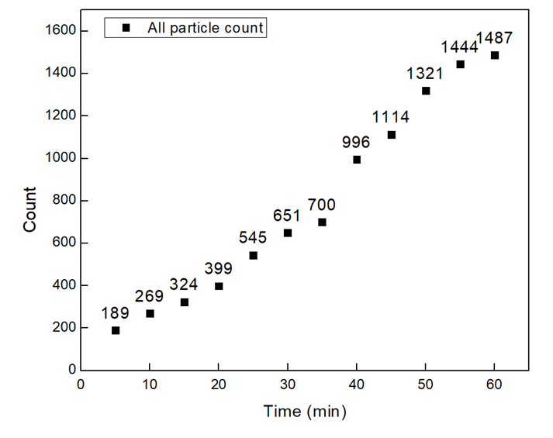
PANORAMA of Plasma Sample 163 (Prediction: Cancer)
Time: 60 min
Count: 1487 (Ex: 537; Large: 163)
Time: 60 min wash
Count: 149
Based On Count: Before wash matches CI of stage 1 (950-1558)
After wash count matches CI stage 1 (151-370)
Note: 0% response to miRNA-21
Scale bar: 10 µm

Slide 3
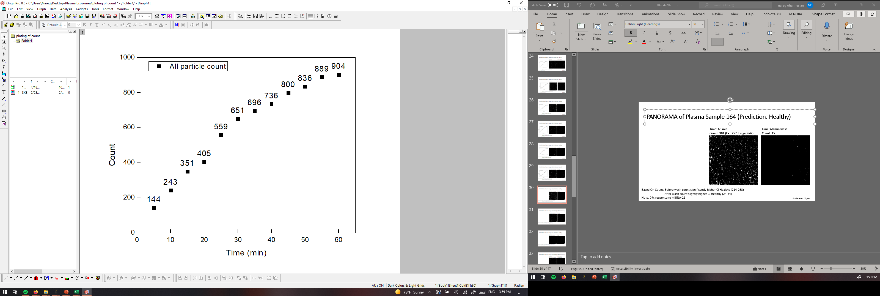

PANORAMA of Plasma Sample 164 (Prediction: Healthy)
Time: 60 min
Count: 904 (Ex: 257; Large: 647)
Time: 60 min wash
Count: 45
Based On Count: Before wash count significantly higher CI Healthy (214-263)
After wash count slightly higher CI Healthy (24-34)
Note: 0 % response to miRNA-21
Scale bar: 10 µm

Slide 4
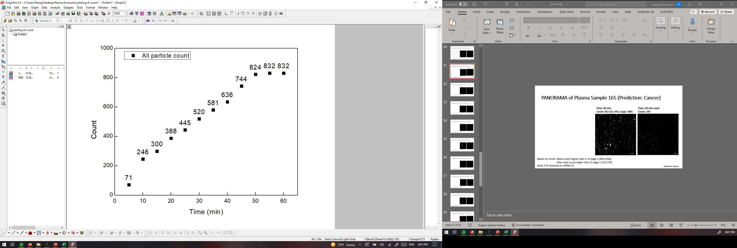
PANORAMA of Plasma Sample 165 (Prediction: Cancer)
Time: 60 min
Count: 832 (Ex: 443; Large: 389)
Time: 60 min wash
Count: 293
Based On Count: Before wash higher than CI of stage 1 (950-1558)
After wash count higher than CI stage 1 (151-370)
Note: 0 % response to miRNA-21
Scale bar: 10 µm

Slide 5

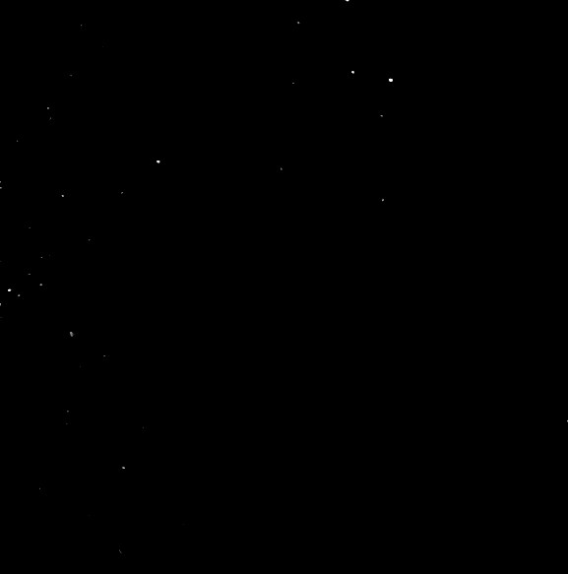
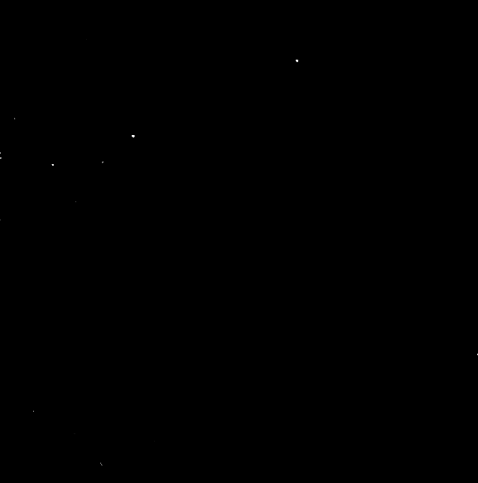
PANORAMA of Plasma Sample 166 (Prediction: Healthy)
Time: 60 min
Count: 30 (Ex: 30; Large: 0)
Time: 60 min wash
Count: 9
Based On Count: Before wash count significantly lower CI Healthy (214-263)
After wash count lower CI Healthy (24-34)
Note: 0 % response to miRNA-21
Scale bar: 10 µm

Slide 6
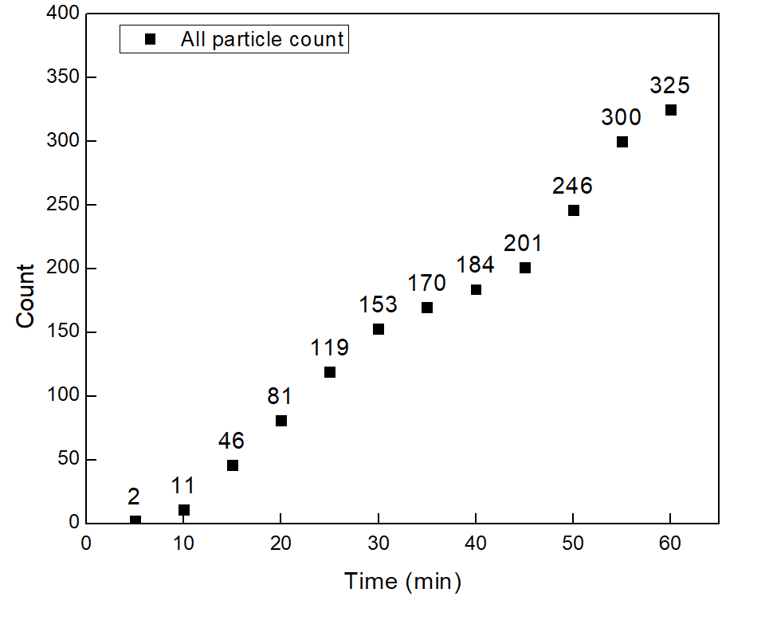


PANORAMA of Plasma Sample 167 (Prediction: Cancer )
Time: 60 min
Count: 325 (Ex: 537; Large: 163)
Time: 60 min wash
Count: 74 (Grey zone)
Based On Count: Before wash lower CI of stage 1 (950-1558)
After wash lower CI stage 1 (151-370)
Note: 7% response to miRNA-21
Scale bar: 10 µm

Slide 7

PANORAMA of Plasma Sample 168 (Prediction: Healthy)
Time: 60 min
Count: 203 (Ex: 111; Large: 92)
Time: 60 min wash
Count: 68
Based On Count: Before wash count matches CI Healthy (214-263)
After wash count higher CI Healthy (24-34)
Note: 0 % response to miRNA-21
Scale bar: 10 µm

Slide 8

PANORAMA of Plasma Sample 169 (Prediction: Cancer)
Time: 60 min
Count: 369 (Ex: 314; Large: 55)
Time: 60 min wash
Count: 251
Based On Count: Before wash lower than CI of stage 1 (950-1558)
After wash count matches CI stage 1 (151-370)
Note: 0 % response to miRNA-21
Scale bar: 10 µm

Slide 9



PANORAMA of Plasma Sample 170 (Prediction: Cancer)
Time: 60 min
Count: 919 (Ex: 720; Large: 199)
Time: 60 min wash
Count: 236
Based On Count: Before wash slightly lower CI of stage 1 (950-1558)
After wash count matches than CI stage 1 (151-370)
Note: 61 % response to miRNA-21
Scale bar: 10 µm

Slide 10
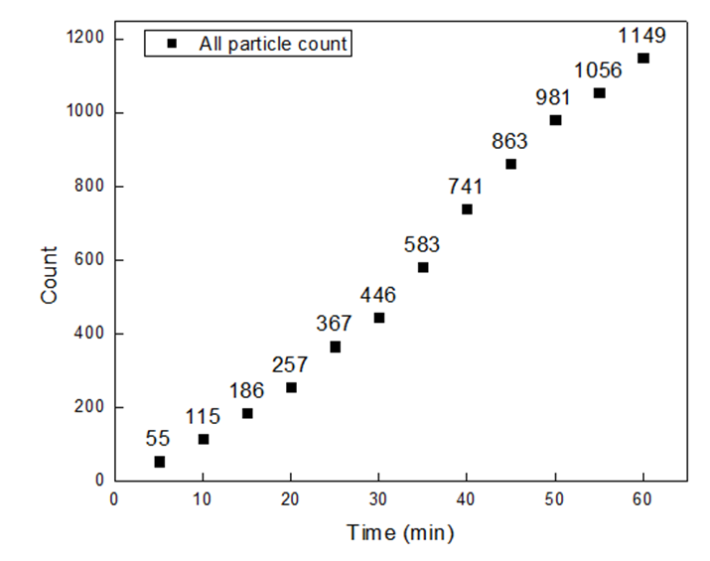
PANORAMA of Plasma Sample 171 (Prediction: Cancer)
Time: 60 min
Count: 1149 (Ex: 861; Large: 288)
Time: 60 min wash
Count: 120
Based On Count: Before wash matches CI of stage 1 (950-1558)
After wash count lower than CI stage 1 (151-370)
Note: 0 % response to miRNA-21
Scale bar: 10 µm

Slide 11
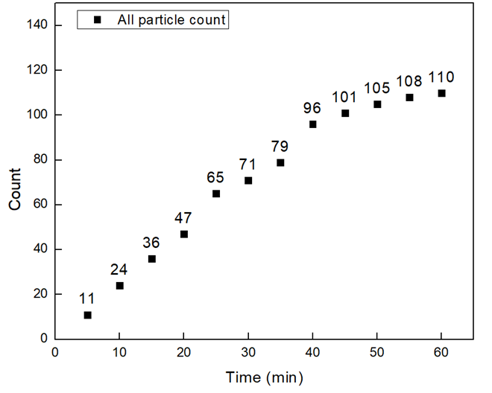
PANORAMA of Plasma Sample 172 (Prediction: Healthy)
Time: 60 min
Count: 110 (Ex: 82; Large: 28)
Time: 60 min wash
Count: 22
Based On Count: Before wash count lower CI Healthy (214-263)
After wash count lower CI Healthy (24-34)
Note: 0 % response to miRNA-21
Scale bar: 10 µm

Slide 12
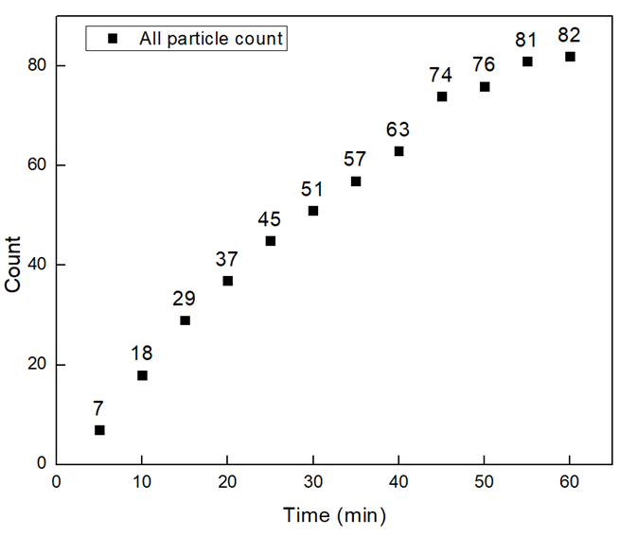


PANORAMA of Plasma Sample 173 (Prediction: Healthy)
Time: 60 min
Count: 82 (Ex: 69; Large: 13)
Time: 60 min wash
Count: 27
Based On Count: Before wash count lower CI Healthy (214-263)
After wash count matches CI Healthy (24-34)
Note: 0 % response to miRNA-21
Scale bar: 10 µm

Slide 13
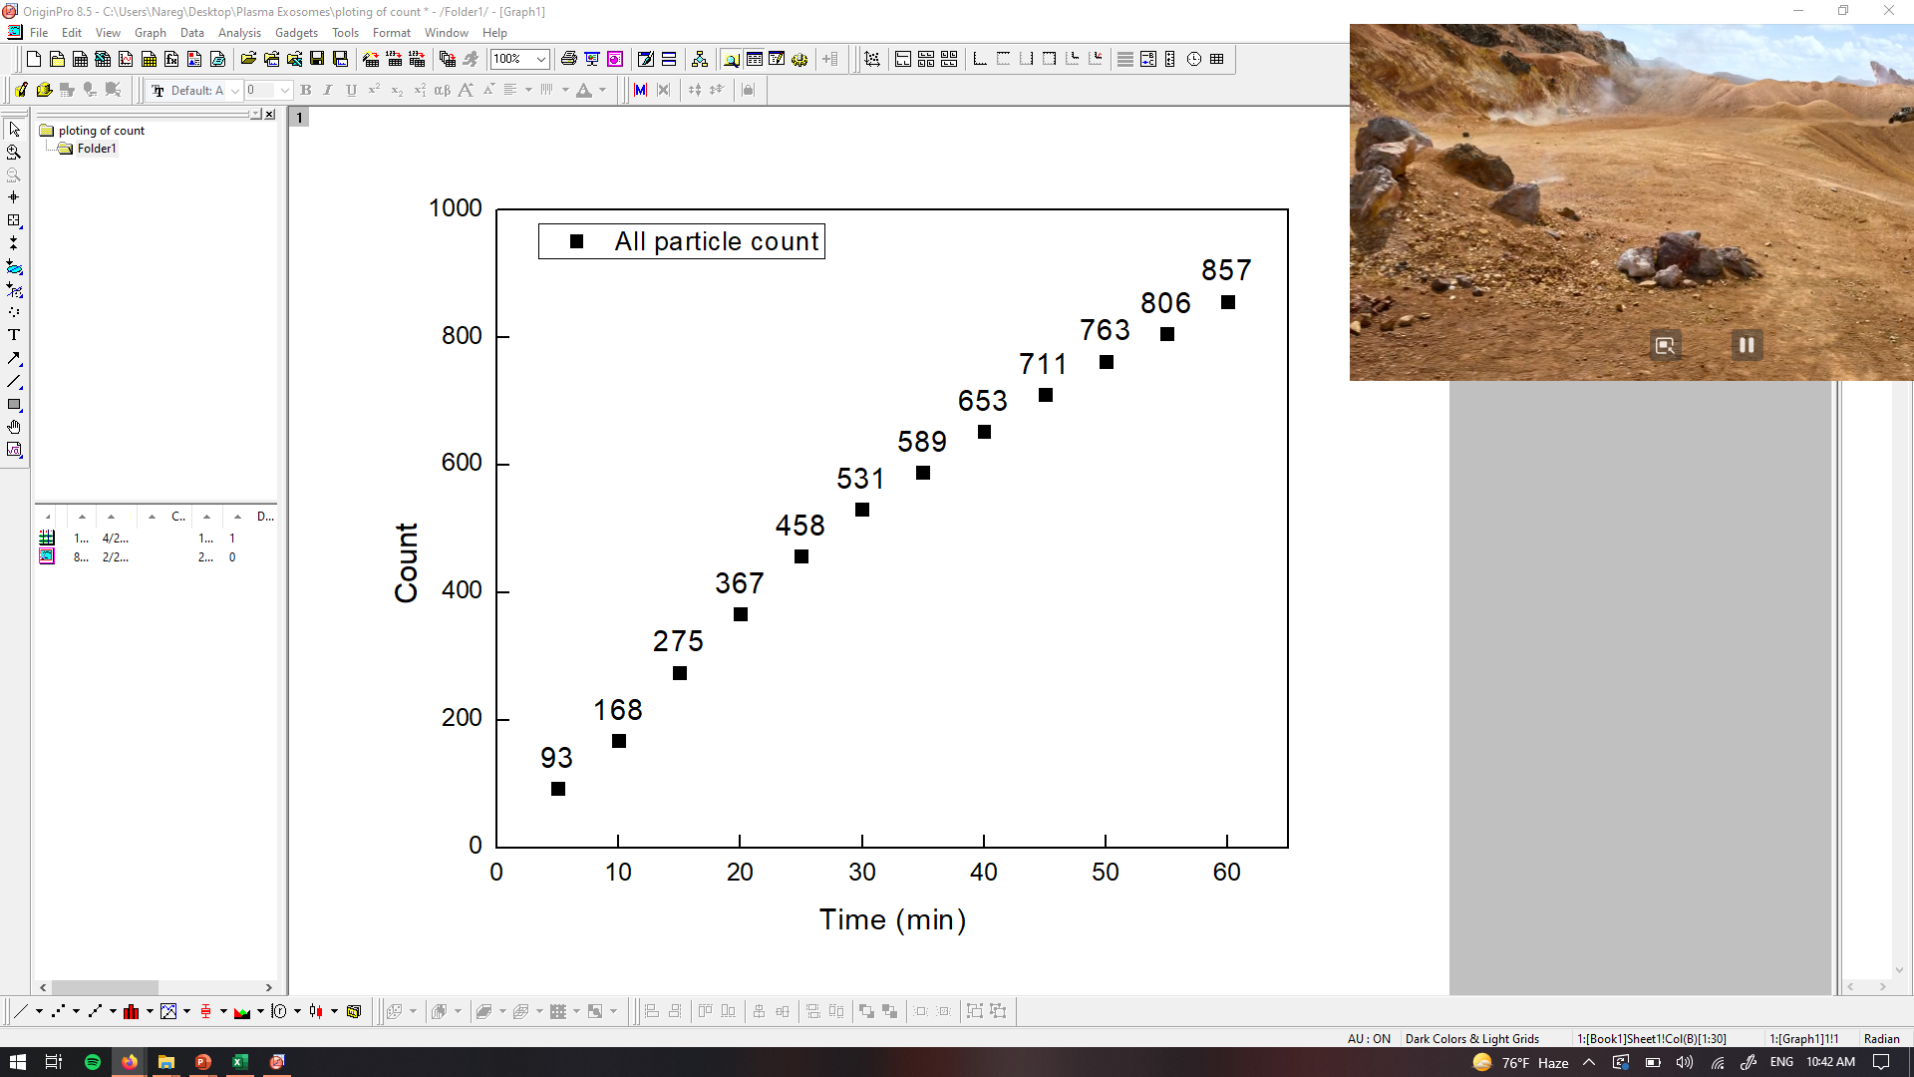
PANORAMA of Plasma Sample 174(Prediction: Cancer)
Time: 60 min
Count: 857 (Ex: 747; Large: 110)
Time: 60 min wash
Count: 200
Based On Count: Before wash matches CI of stage 1 (950-1558)
After wash count matches CI stage 1 (151-370)
Note: 15 % response to miRNA-21
Scale bar: 10 µm

Slide 14
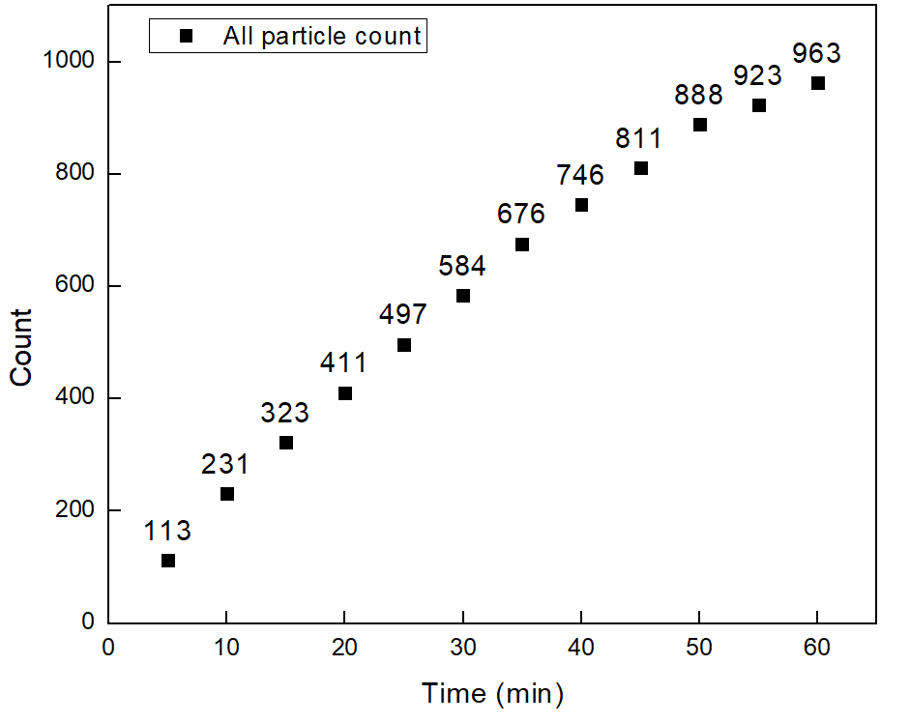
PANORAMA of Plasma Sample 175(Prediction: Cancer)
Time: 60 min
Count: 963 (Ex: 902; Large: 61)
Time: 60 min wash
Count: 418
Based On Count: Before wash matches CI of stage 1 (950-1558)
After wash count exceeds CI stage 1 (151-370)
Note: 17.6 % response to miRNA-21
Scale bar: 10 µm

Slide 15
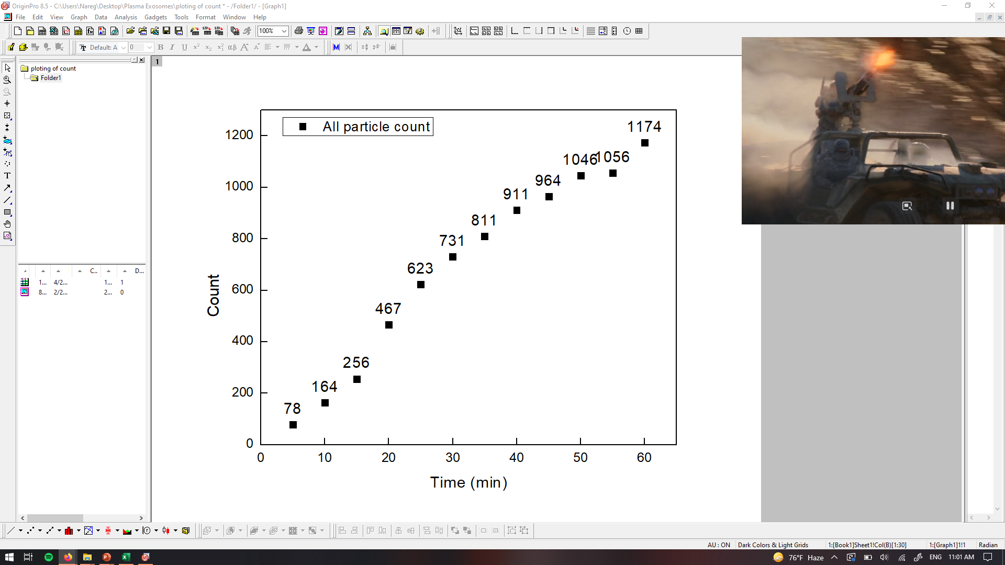
PANORAMA of Plasma Sample 176(Prediction: Cancer)
Time: 60 min
Count: 1174 (Ex: 1015; Large: 159)
Time: 60 min wash
Count: 447
Based On Count: Before wash matches CI of stage 1 (950-1558)
After wash count exceeds CI stage 1 (151-370)
Note: 35 % response to miRNA-21
Scale bar: 10 µm

Slide 16
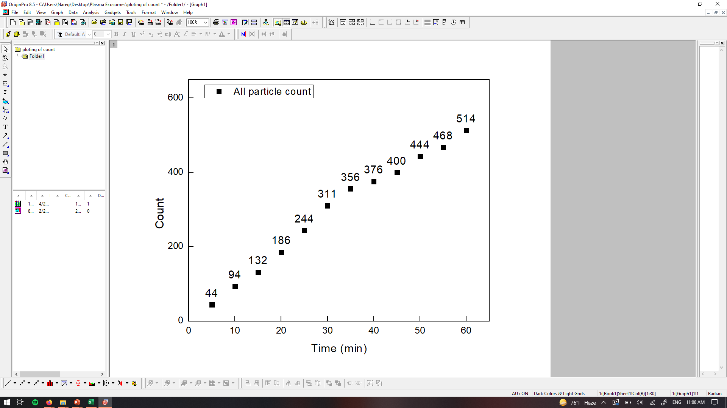
PANORAMA of Plasma Sample 177 (Prediction: Healthy)
Time: 60 min
Count: 514 (Ex: 233; Large: 281)
Time: 60 min wash
Count: 46
Based On Count: Before wash count lower CI Healthy (214-263)
After wash count slightly higher CI Healthy (24-34)
Note: 0 % response to miRNA-21
Scale bar: 10 µm

Slide 17
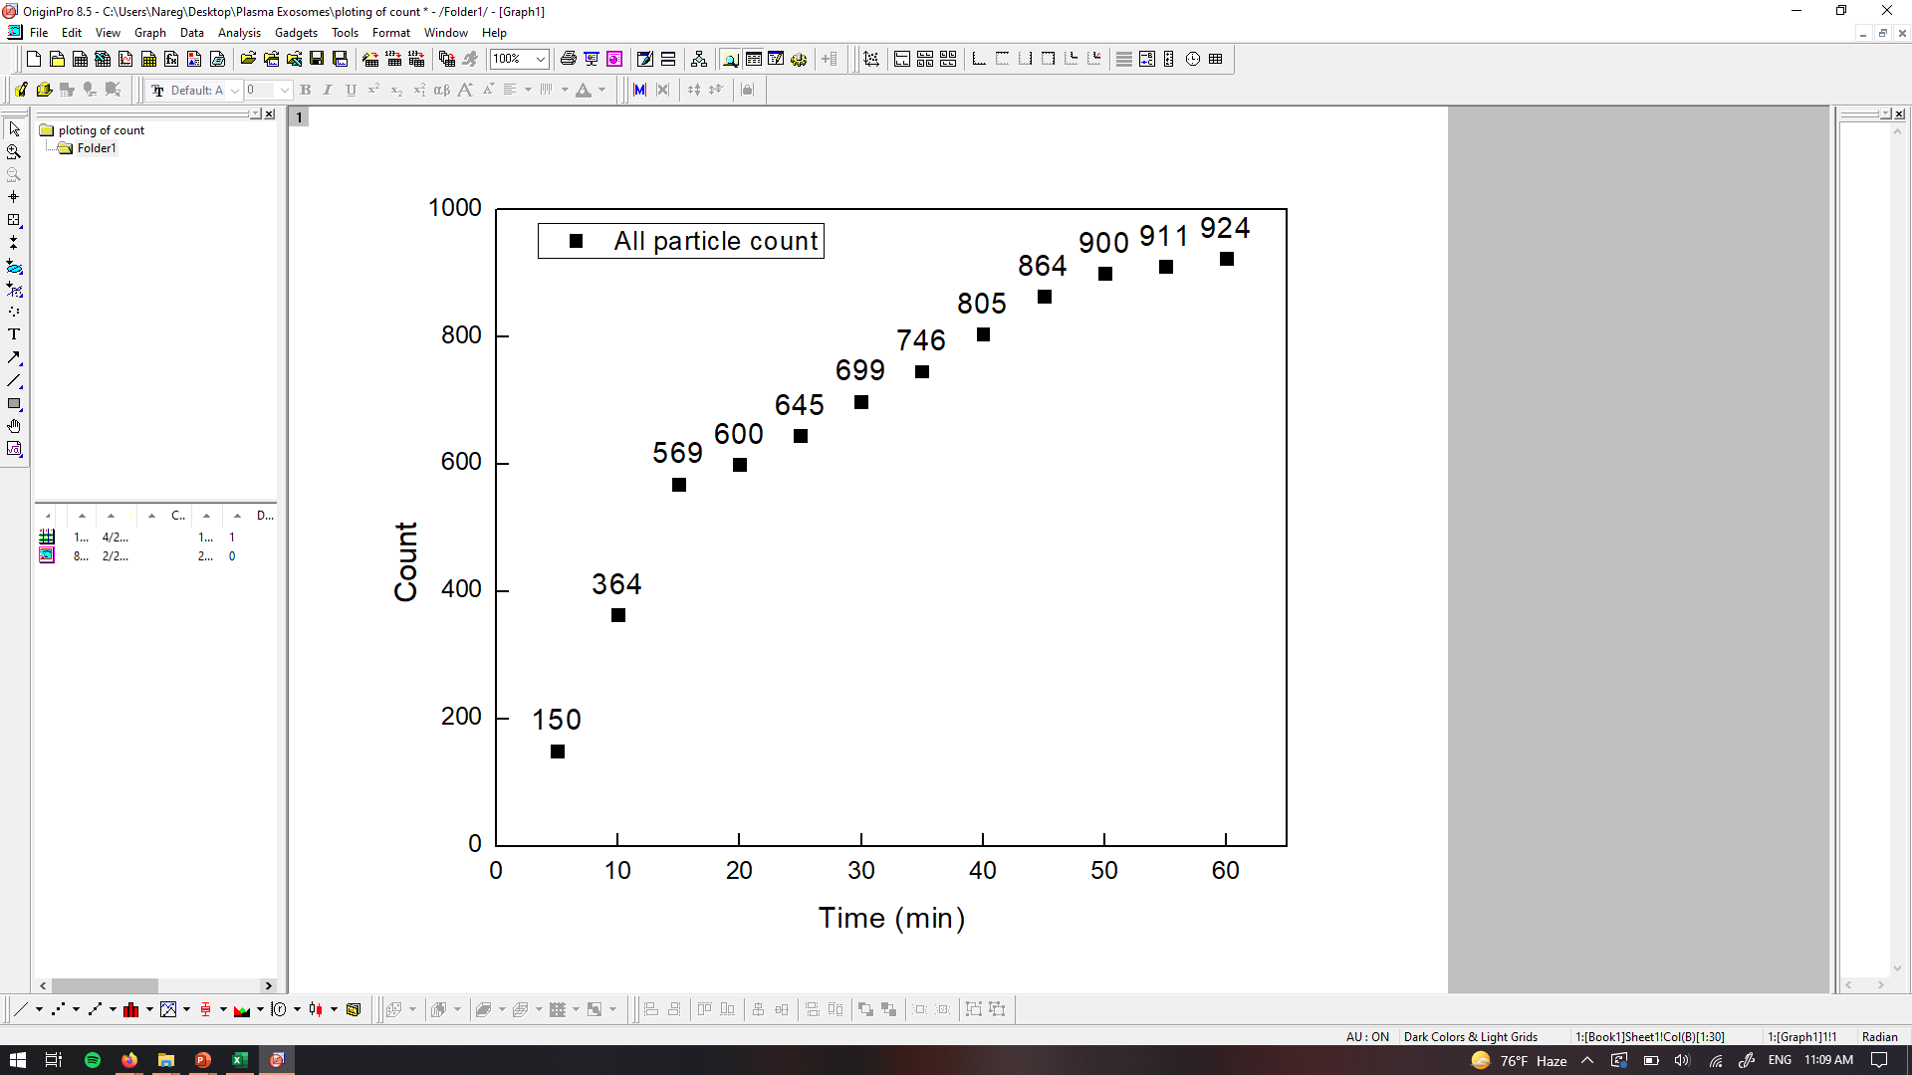
PANORAMA of Plasma Sample 178(Prediction: Cancer)
Time: 60 min
Count: 924 (Ex: 757; Large: 167)
Time: 60 min wash
Count: 140
Based On Count: Before wash slightly lower CI of stage 1 (950-1558)
After wash count slightly lower CI stage 1 (151-370)
Note: 5 % response to miRNA-21
Scale bar: 10 µm

Slide 18
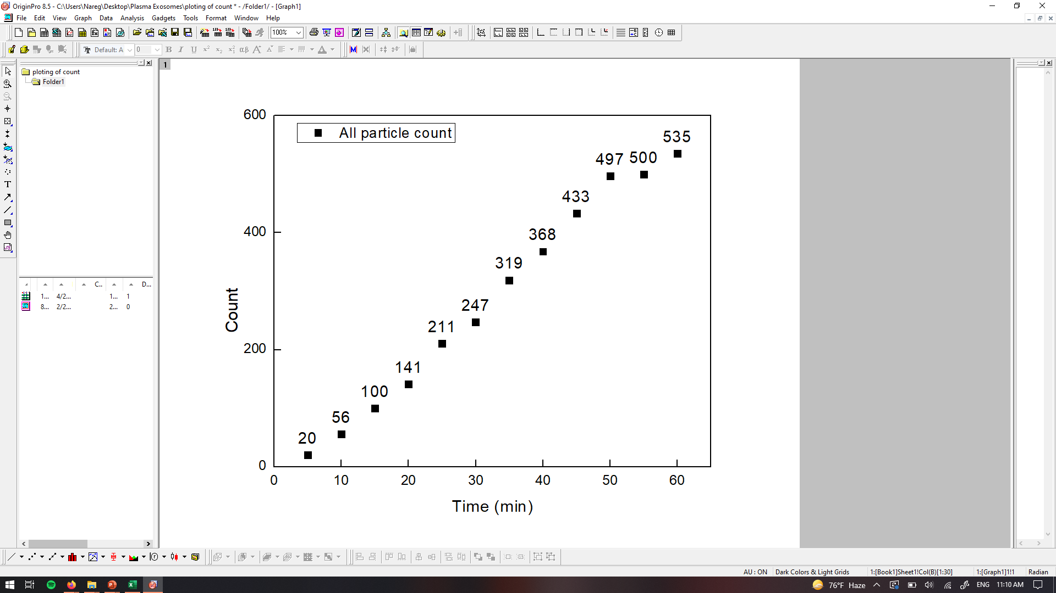
PANORAMA of Plasma Sample 179(Prediction: Cancer)
Time: 60 min
Count: 535 (Ex: 431; Large: 104)
Time: 60 min wash
Count: 152
Based On Count: Before wash lower CI of stage 1 (950-1558)
After wash count matches CI stage 1 (151-370)
Note: 25 % response to miRNA-21
Scale bar: 10 µm

Slide 19
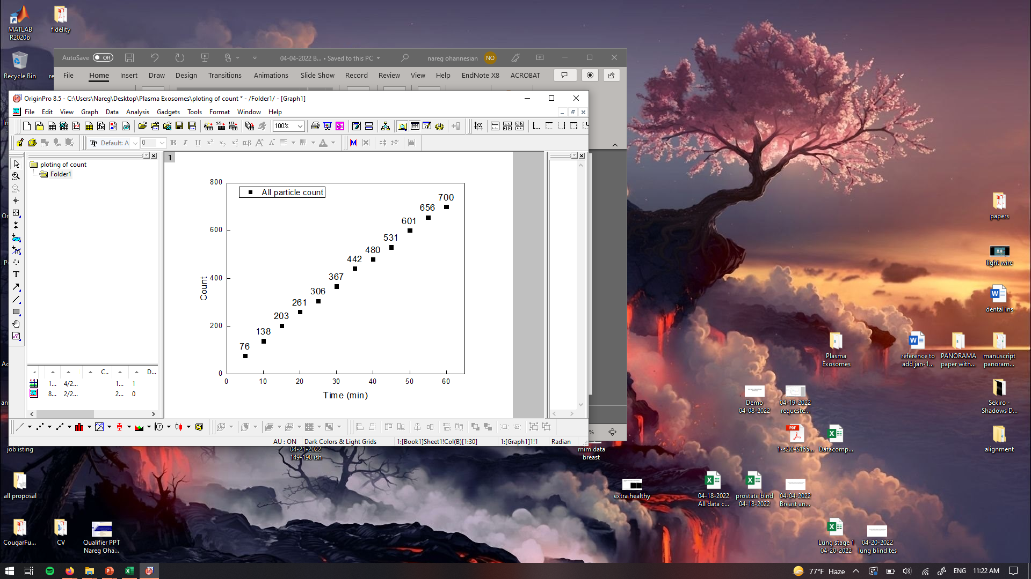
PANORAMA of Plasma Sample 180(Prediction: Cancer)
Time: 60 min
Count: 700 (Ex: 537; Large: 163)
Time: 60 min wash
Count: 195
Based On Count: Before wash slightly lower CI of stage 1 (950-1558)
After wash count matches CI stage 1 (151-370)
Note: 4 % response to miRNA-21
Scale bar: 10 µm

Slide 20
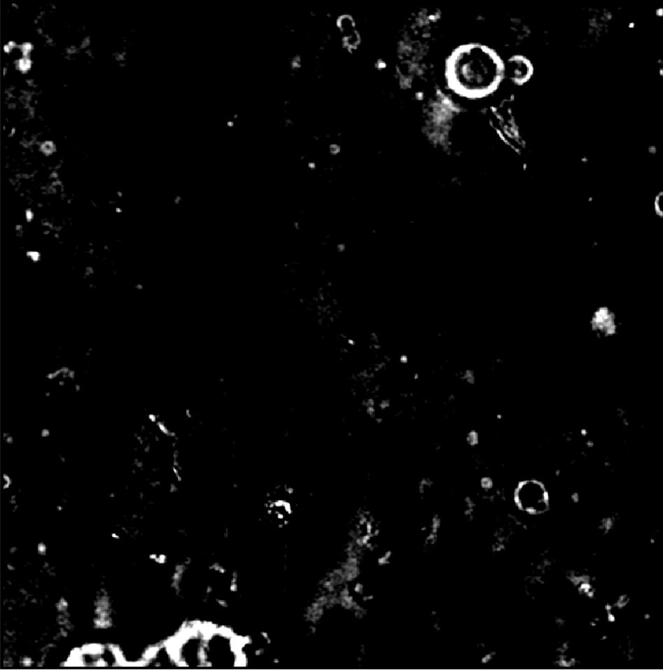
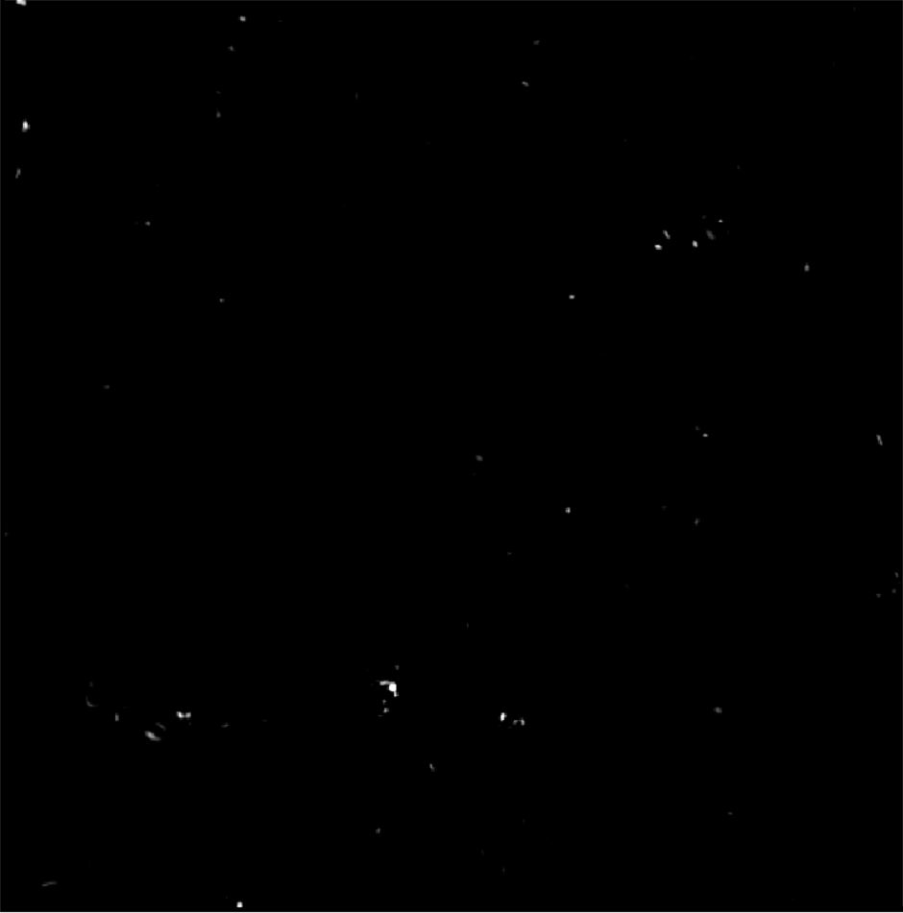
Image of Detected Particles via PANORAMA (181)
Time: 60 min
Count: 229 (Ex: 172; Large: 57)
Time: 60 min wash
Count: 49
Based On Count: Before wash count matches CI Healthy (64-172)
After wash count higher than 99% CI Healthy (5-35) but lower than 70
Note: 0 % response to miRNA-21
Look healthy
Scale Bar: 10 µm

Slide 21
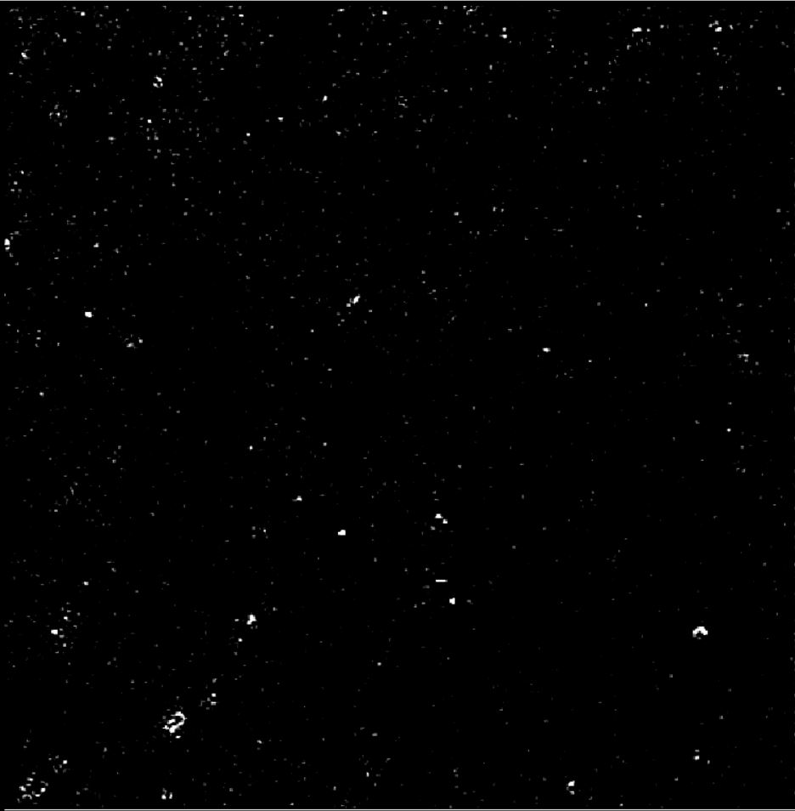

Image of Detected Particles via PANORAMA (182)
Time: 60 min
Count: 323 (Ex: 295; Large: 28)
Time: 60 min wash
Count: 138
Based On Count: Before wash count lower than CI of stage 1 (950-1558)
After wash lower than CI stage 1 (151-370) but
higher than Healthy (5-70)
Note: 17 % response to miRNA-21
Looks cancerous
Scale Bar: 10 µm

Slide 22
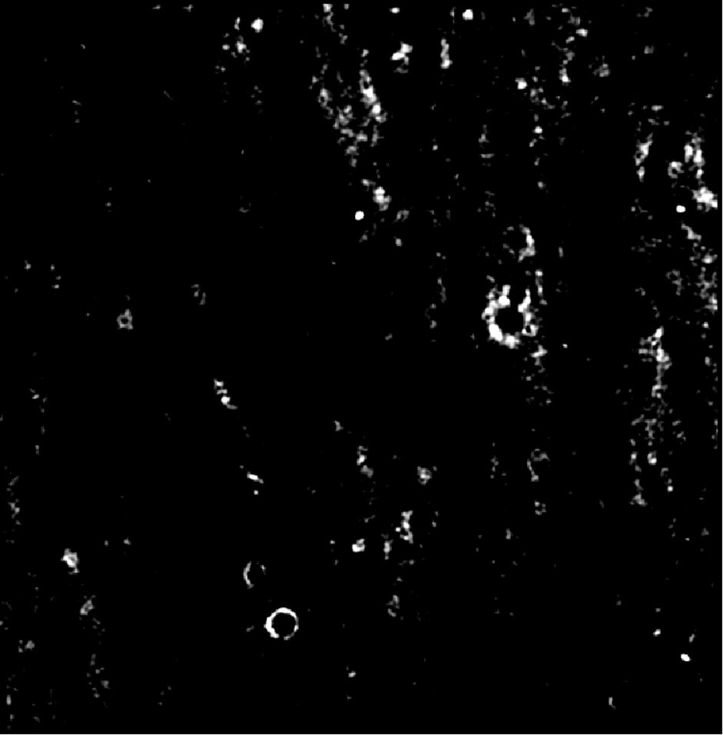
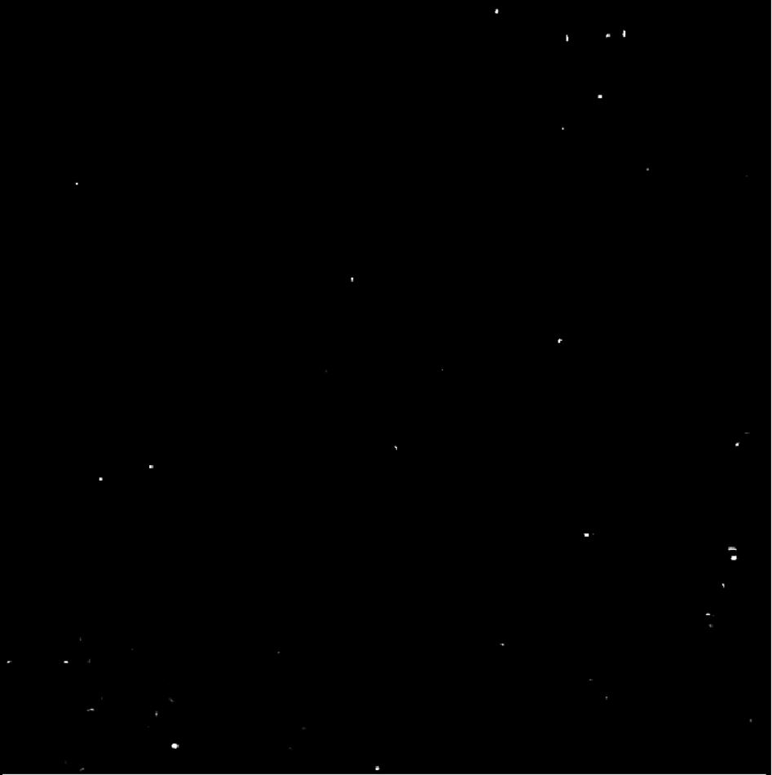
Image of Detected Particles via PANORAMA (184)
Time: 60 min
Count: 224 (Ex: 194; Large: 30)
Time: 60 min wash
Count: 65
Based On Count: Before wash count matches CI Healthy (64-172)
After wash count higher than 99% CI Healthy (5-35) but lower than 70
Note: 0 % response to miRNA-21
Look healthy
Scale Bar: 10 µm

Slide 23
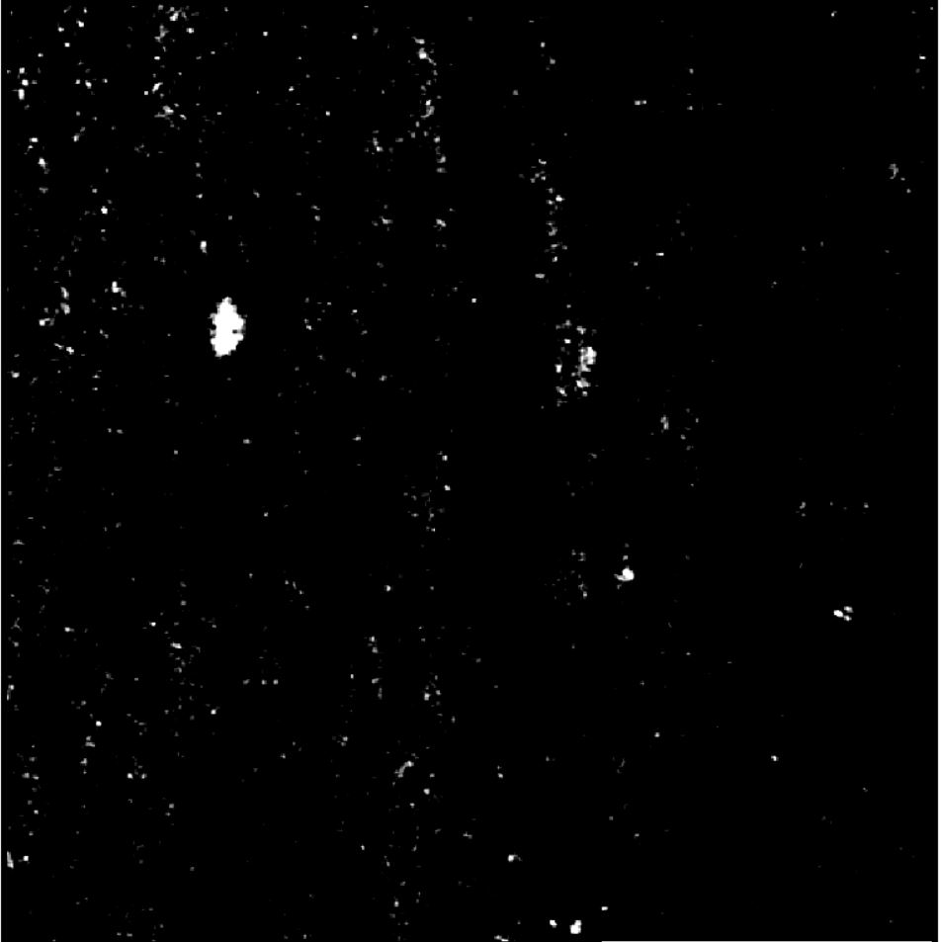
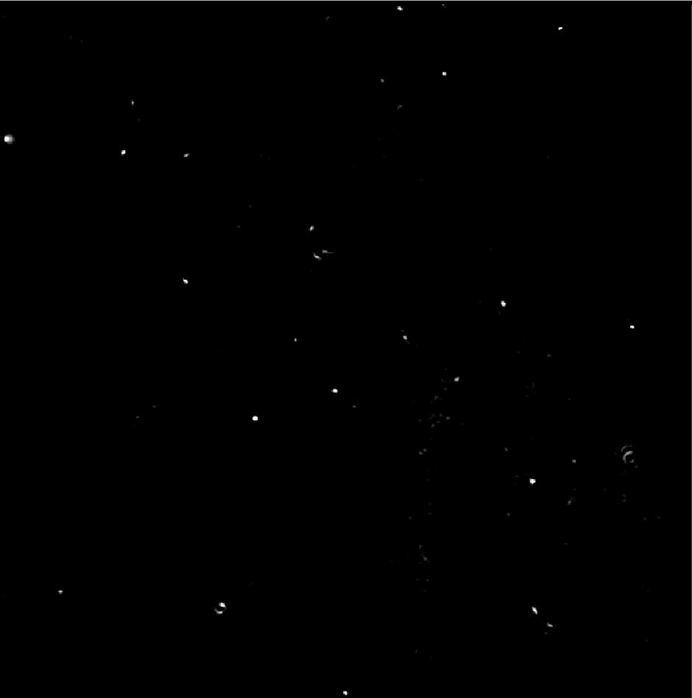
Image of Detected Particles via PANORAMA (186)
Time: 60 min
Count: 292 (Ex: 254; Large: 38)
Time: 60 min wash
Count: 49
Based On Count: Before wash count matches CI Healthy (64-172)
After wash count higher than 99% CI Healthy (5-35) but lower than 70
Note: 0 % response to miRNA-21
Look healthy
Scale Bar: 10 µm

Slide 24
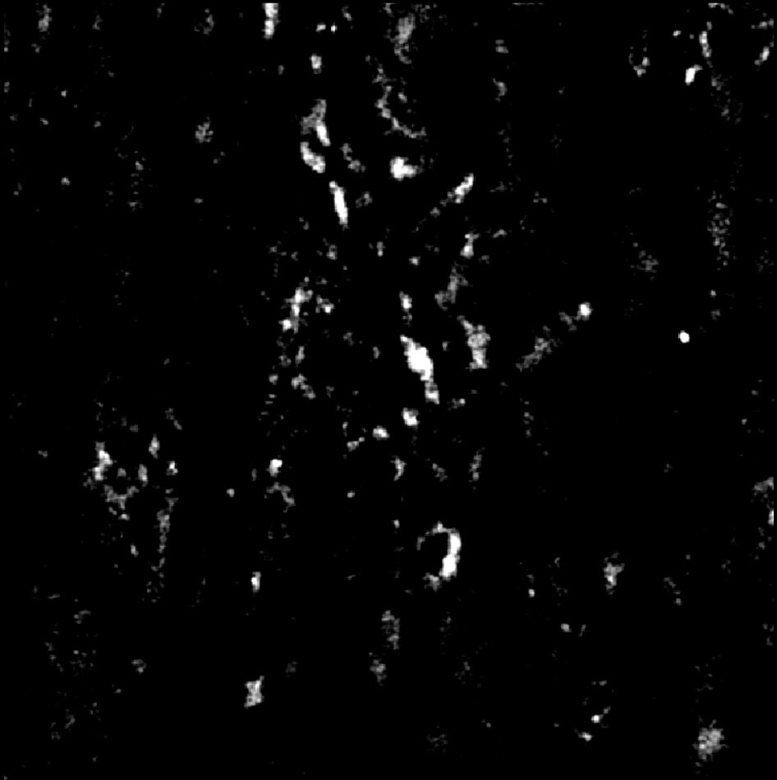
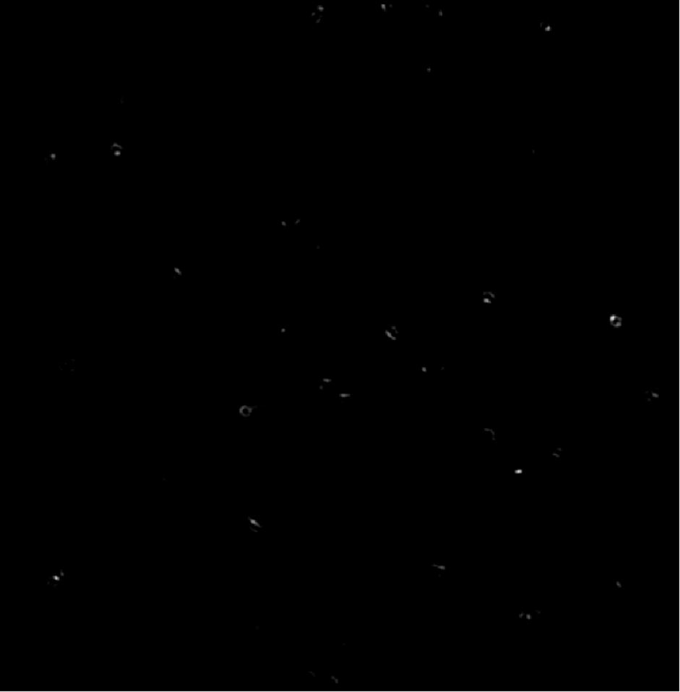
Image of Detected Particles via PANORAMA (187)
Time: 60 min
Count: 243 (Ex: 187; Large: 56)
Time: 60 min wash
Count: 39
Based On Count: Before wash count matches CI Healthy (64-172)
After wash count higher than 99% CI Healthy (5-35) but lower than 70
Note: 0 % response to miRNA-21
Look healthy
Scale Bar: 10 µm

Slide 25
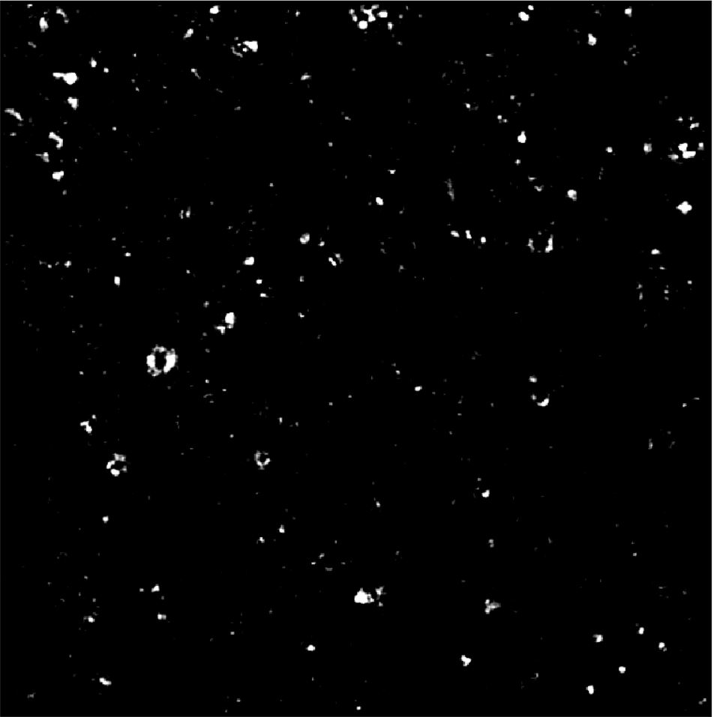
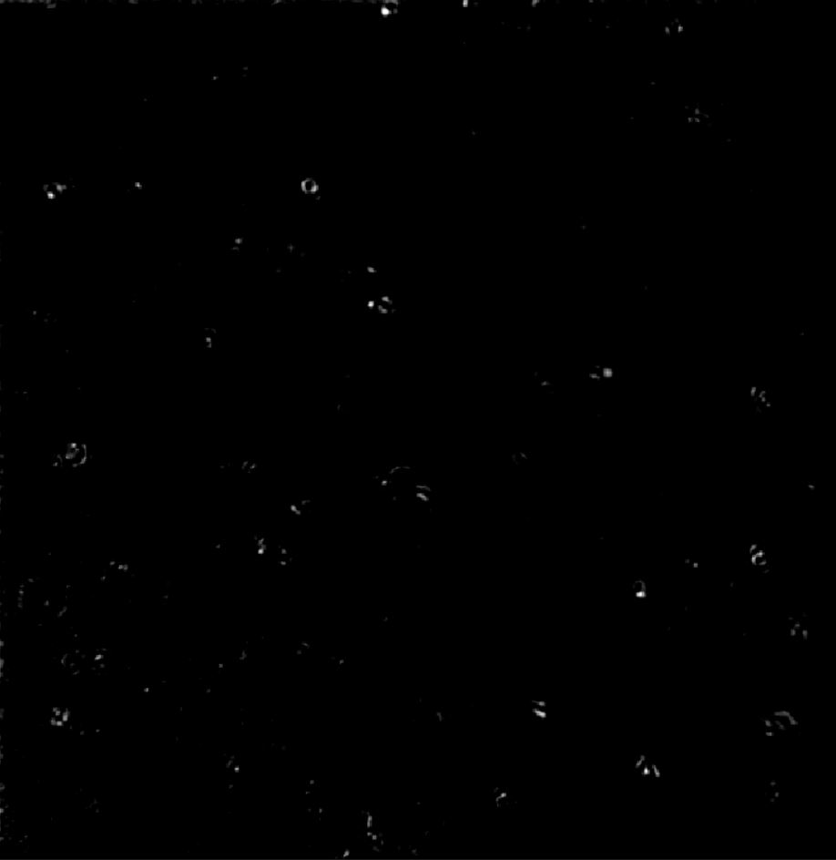
Image of Detected Particles via PANORAMA (188)
Time: 60 min
Count: 310 (Ex: 260; Large: 50)
Time: 60 min wash
Count: 125
Based On Count: Before wash count lower than CI of stage 1 (950-1558)
After wash lower than CI stage 1 (151-370) but
higher than Healthy (5-70)
Note: 11.3 % response to miRNA-21
Looks cancerous
Scale Bar: 10 µm

Slide 26
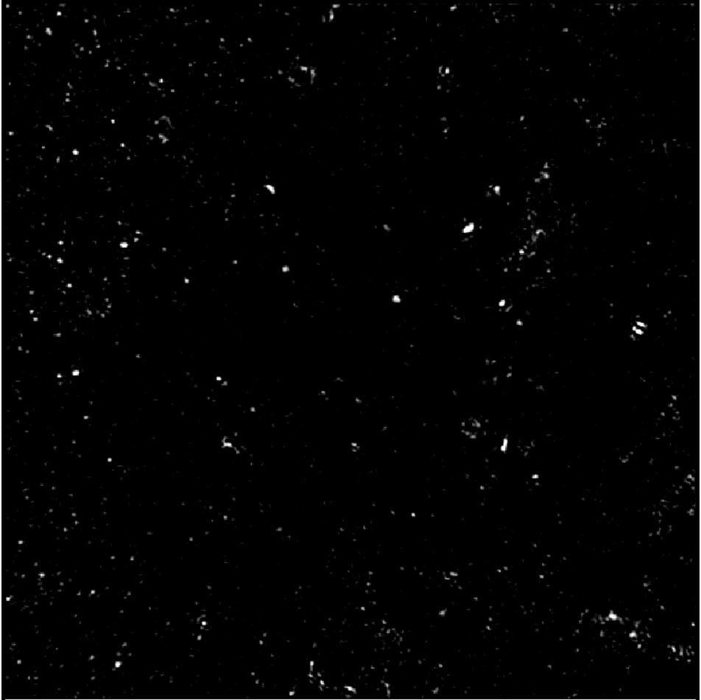
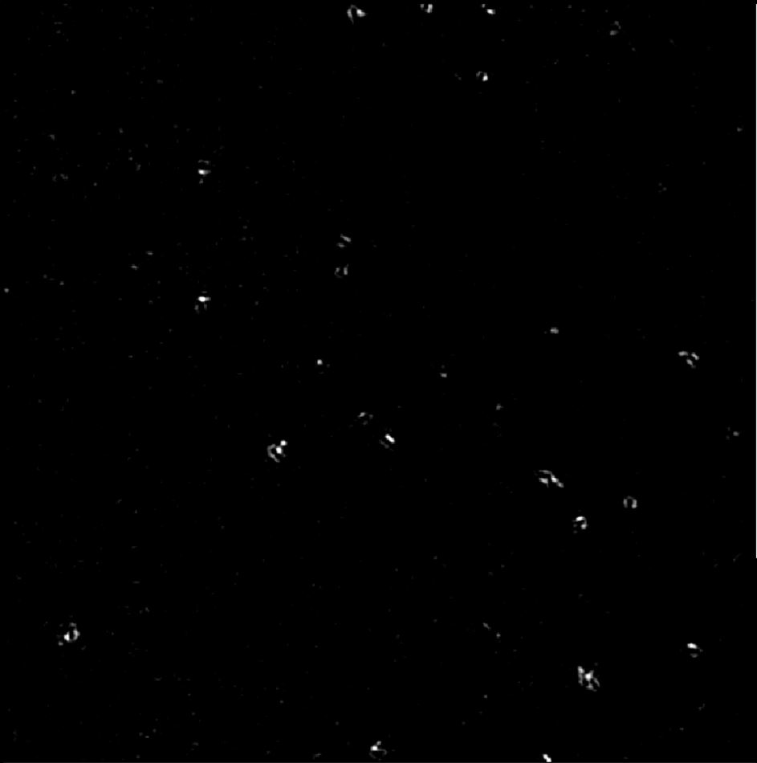
Image of Detected Particles via PANORAMA (189)
Time: 60 min
Count: 362 (Ex: 319; Large: 43)
Time: 60 min wash
Count: 102
Based On Count: Before wash count lower than CI of stage 1 (950-1558)
After wash lower than CI stage 1 (151-370) but
higher than Healthy (5-70)
Note: 7.1 % response to miRNA-21
Looks cancerous
Scale Bar: 10 µm

Slide 27
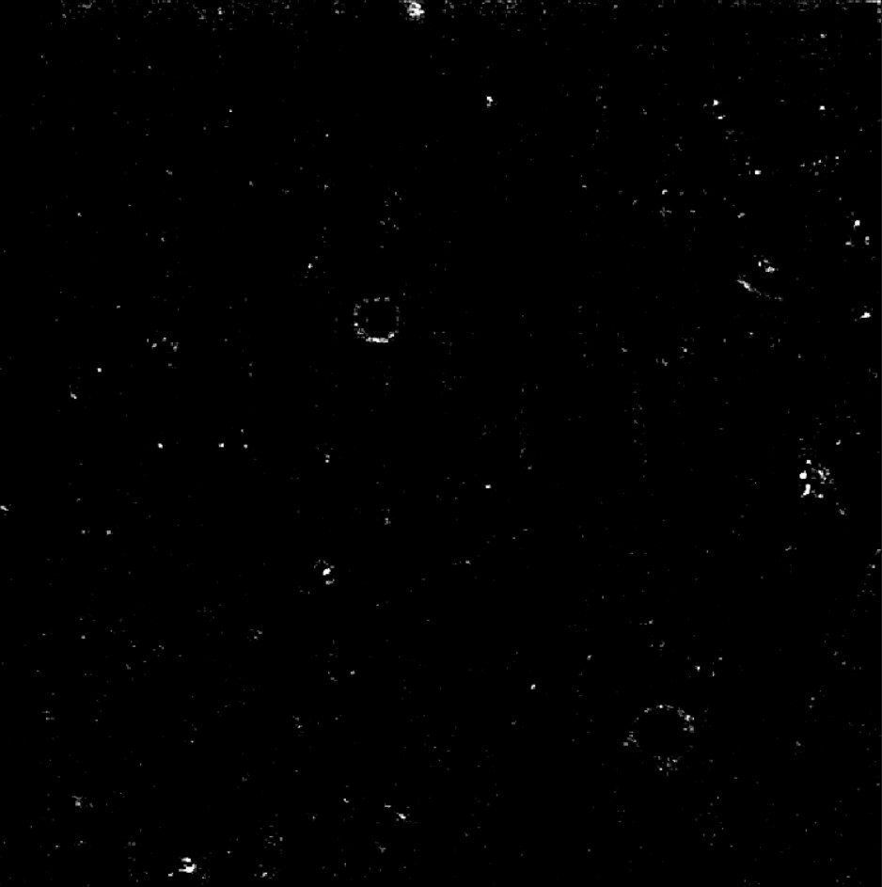

Image of Detected Particles via PANORAMA (190)
Before wash particles: 321
Large particle: 23
Exosome: 298
After wash exosome: 32
Based On Count: Before wash count matches CI Healthy (64-172)
After wash count higher than 99% CI Healthy (5-35) but lower than 70
Note: 0% response to miRNA-21
Looks healthy
Scale Bar: 10 µm

Slide 28
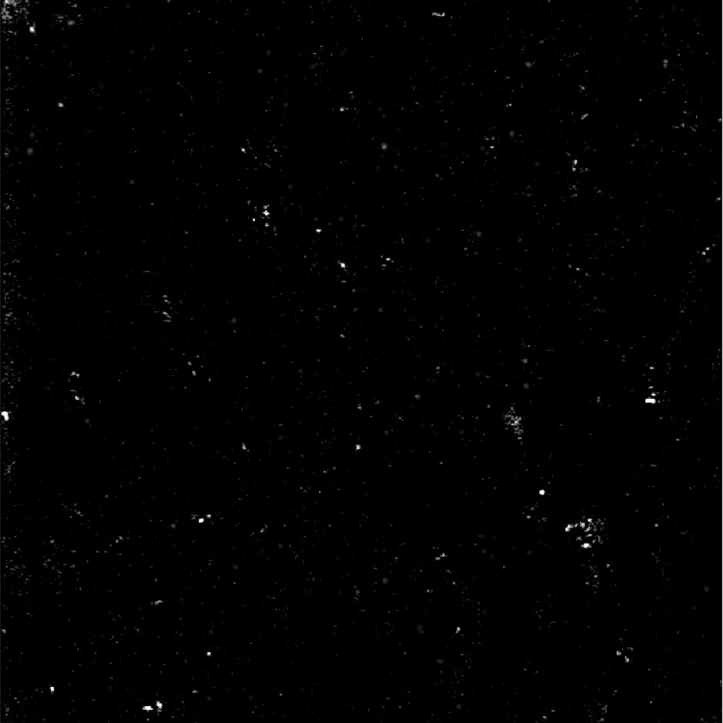

Image of Detected Particles via PANORAMA (191)
Before wash particles: 257
Large particle: 26
Exosome: 231
After wash exosome: 64
Based On Count: Before wash count matches CI Healthy (64-172)
After wash count higher than 99% CI Healthy (5-35) but lower than 70
Note: 0% response to miRNA-21
Looks healthy
Scale Bar: 10 µm

Slide 29
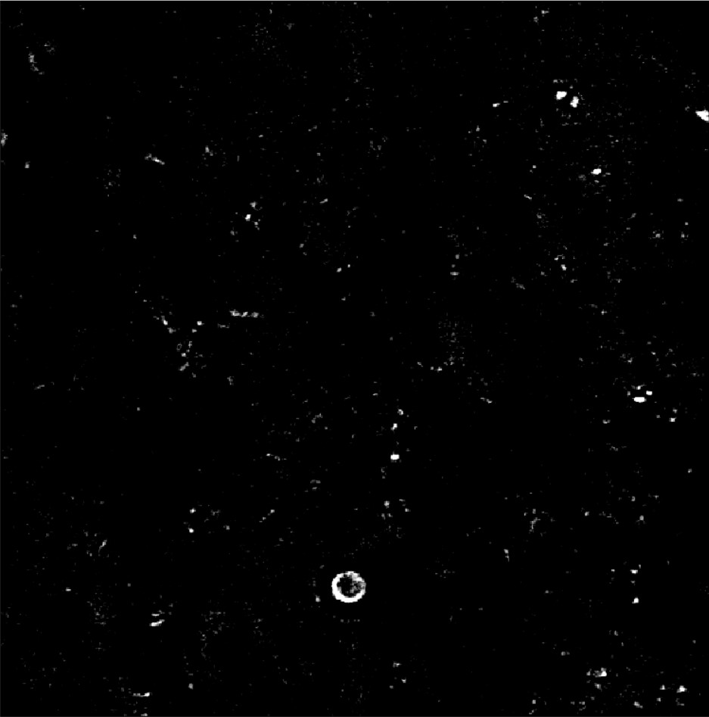

Image of Detected Particles via PANORAMA (193)
Before wash particles: 555
Large particle: 86
Exosome: 469
After wash exosome: 308
Based On Count: Before wash count lower than CI of stage 1 (950-1558)
After wash lower than CI stage 1 (151-370) but
higher than Healthy (5-70)
Note: 15% response to miRNA-21
Looks Cancerous
Scale Bar: 10 µm

Slide 30
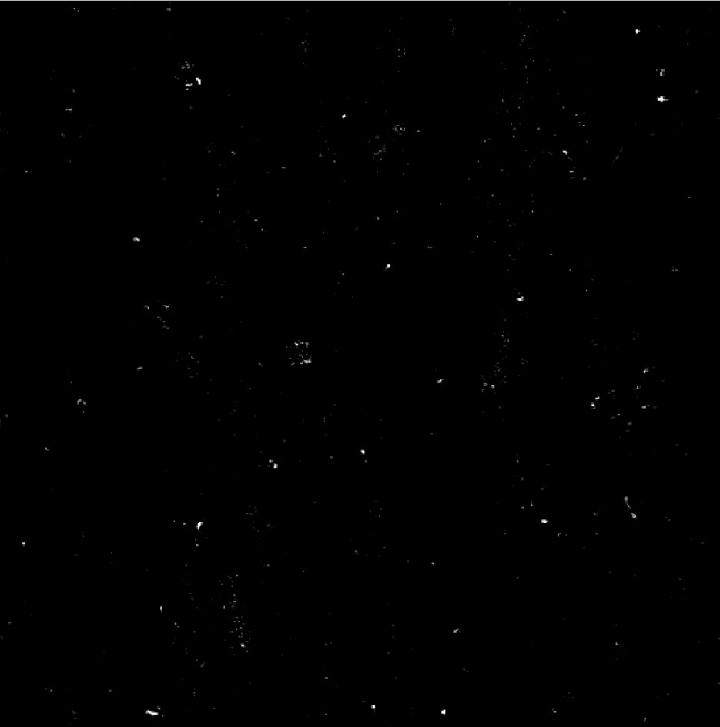

Image of Detected Particles via PANORAMA (194)
Before wash particles: 122
Large particle: 12
Exosome: 110
After wash exosome: 66
Based On Count: Before wash count matches CI Healthy (64-172)
After wash count higher than 99% CI Healthy (5-35) but lower than 70
Note: 0% response to miRNA-21
Looks healthy
Scale Bar: 10 µm

Slide 31
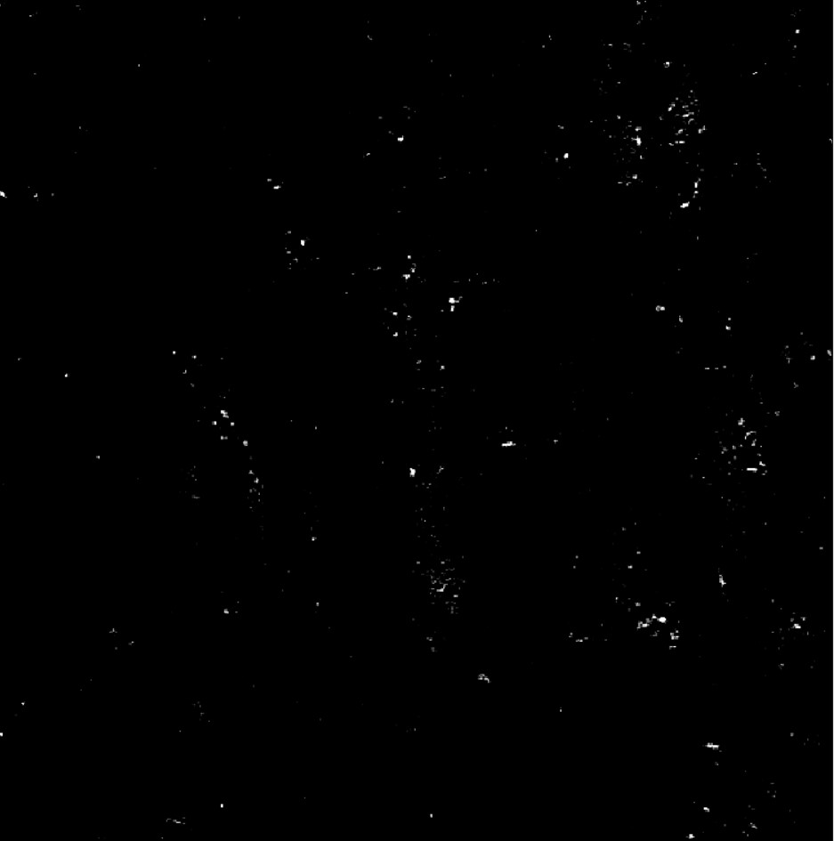

Image of Detected Particles via PANORAMA (195)
Before wash particles: 265
Large particle: 26
Exosome: 239
After wash exosome: 46
Based On Count: Before wash count matches CI Healthy (64-172)
After wash count higher than 99% CI Healthy (5-35) but lower than 70
Note: 0% response to miRNA-21
Looks healthy
Scale Bar: 10 µm

Slide 32
 | Before wash |  |  | After Wash
Number | All particles | Large | Ex like | Retained | MIR-21 (%) | Prediction | Actual state | Sample
138 | 39 | 5 | 34 | 14 | 0 | Healthy | Healthy | HCR 19
139 | 155 | 18 | 137 | 50 | 0 | Healthy | Healthy | HCR 18
140 | 281 | 24 | 257 | 99 | 0 | Cancer | Cancer | 0514-B3
141 | 368 | 30 | 338 | 122 | 22 | Cancer | Cancer | 0514-B4
142 | 539 | 27 | 512 | 153 | 37 | Cancer | Cancer | 0514-B5
143 | 113 | 17 | 96 | 33 | 0 | Healthy | Healthy | HCR 17
144 | 135 | 16 | 119 | 49 | 0 | Healthy | Healthy | HCR 16
145 | 477 | 47 | 430 | 260 | 23 | Cancer | Cancer | 0514-B8
146 | 171 | 13 | 158 | 57 | 0 | Healthy | Healthy | HCR 14
147 | 287 | 26 | 261 | 60 | 0 | Healthy | Healthy | HCR 96
148 | 341 | 27 | 314 | 132 | 17 | Cancer | Cancer | 0514-B9
149 | 192 | 33 | 159 | 64 | 0 | Healthy | Healthy | HCR 1
150 | 144 | 23 | 121 | 56 | 0 | Healthy | Healthy | HCR 2
151 | 398 | 69 | 329 | 192 | 0 | Cancer | Cancer | 0514-B44
152 | 608 | 187 | 421 | 105 | 0 | Cancer | Cancer | 0514-B26
153 | 624 | 100 | 524 | 145 | 0 | Cancer | Cancer | 0514-B33
154 | 300 | 62 | 238 | 43 | 0 | Healthy | Healthy | HCR 72
155 | 2381 | 2133 | 248 | 171 | 17 | Cancer | Cancer | 0514-B10
156 | 1358 | 245 | 1113 | 35 | 0 | Healthy | Healthy | HCR 97
157 | 1504 | 180 | 1321 | 439 | 3 | Cancer | Cancer | 0514-B11
158 | 629 | 61 | 568 | 176 | 0 | Cancer | Cancer | 0514-B13
159 | 3335 | 526 | 2809 | 1682 | 20 | Cancer | Cancer | 0514-B15
160 | 442 | 196 | 246 | 15 | 0 | Healthy | Healthy | HCR 7
161 | 899 | 170 | 729 | 187 | 0 | Cancer | Cancer | 0514-B37
162 | 101 | 29 | 72 | 16 | 0 | Healthy | Healthy | HCR 87
163 | 1487 | 163 | 537 | 149 | 0 | Cancer | Cancer | 0514-B46
164 | 904 | 647 | 257 | 45 | 0 | Healthy | Healthy | HCR 157
165 | 832 | 389 | 443 | 293 | 0 | Cancer | Cancer | 0514-B17
166 | 30 | 30 | 0 | 9 | 0 | Healthy | Healthy | HCR 158
167 | 325 | 163 | 537 | 74 | 7 | Cancer | Cancer | 0514-B38

Slide 33
 | Before wash |  |  | After Wash
Number | All particles | Large | Ex like | Retained | MIR-21 (%) | Prediction | Actual state | Sample
168 | 203 | 92 | 111 | 68 | 0 | Healthy | Healthy | HCR 140
169 | 369 | 55 | 314 | 251 | 0 | Cancer | Cancer | 0514-B19
170 | 919 | 199 | 720 | 236 | 61 | Cancer | Cancer | 0514-B22
171 | 1149 | 288 | 861 | 120 | 0 | Cancer | Cancer | 0514-B25
172 | 110 | 28 | 82 | 22 | 0 | Healthy | Healthy | HCR 160
173 | 82 | 13 | 69 | 27 | 0 | Healthy | Healthy | HCR 82
174 | 857 | 110 | 747 | 200 | 15 | Cancer | Cancer | 0514-B23
175 | 963 | 61 | 902 | 418 | 17.6 | Cancer | Cancer | 0514-B12
176 | 1174 | 159 | 1015 | 447 | 35 | Cancer | Cancer | 0514-B47
177 | 514 | 281 | 233 | 46 | 0 | Healthy | Healthy | HCR 153
178 | 924 | 167 | 757 | 140 | 5 | Cancer | Cancer | 0514-B45
179 | 535 | 104 | 431 | 152 | 25 | Cancer | Cancer | 0514-B36
180 | 700 | 163 | 537 | 195 | 4 | Cancer | Cancer | 0514-B34
181 | 229 | 57 | 172 | 49 | 0 | Healthy | Healthy | HCR 154
182 | 323 | 28 | 295 | 138 | 17 | Cancerous | Cancerous | 0514-B39
184 | 224 | 30 | 194 | 65 | 0 | Healthy | Healthy | HCR 152
186 | 292 | 38 | 254 | 49 | 0 | Healthy | Healthy | HCR 3
187 | 243 | 56 | 187 | 39 | 0 | Healthy | Healthy | HCR 5
188 | 310 | 50 | 260 | 125 | 11.3 | Cancerous | Cancerous | 0514-B42
189 | 362 | 43 | 319 | 102 | 7.1 | Cancerous | Cancerous | 0514-B43
190 | 321 | 23 | 298 | 32 | 0 | Healthy | Healthy | HCR 28
191 | 257 | 26 | 231 | 64 | 0 | Healthy | Healthy | HCR 6
193 | 555 | 86 | 469 | 308 | 15 | Cancerous | Cancerous | 0514-B31
194 | 122 | 12 | 110 | 66 | 0 | Healthy | Healthy | HCR 155
195 | 265 | 26 | 239 | 46 | 0 | Healthy | Healthy | HCR 156

Slide 34
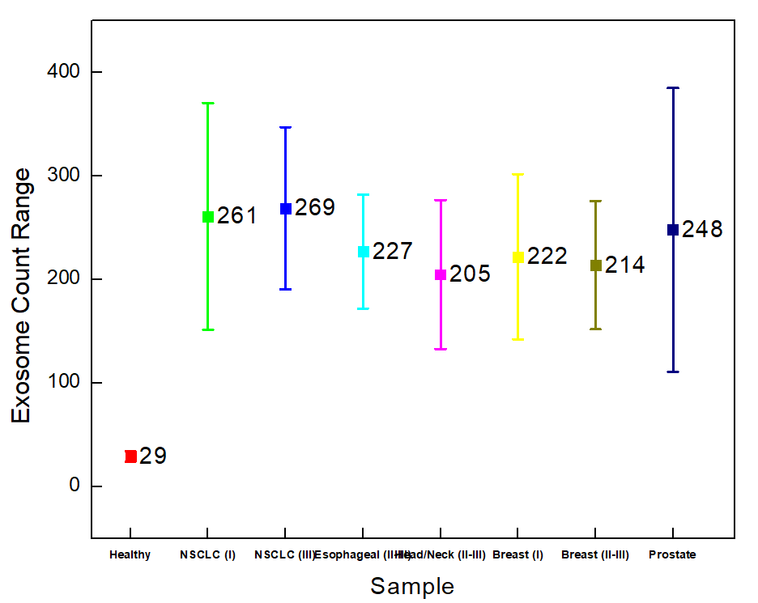
99% Confidence Interval

Slide 35
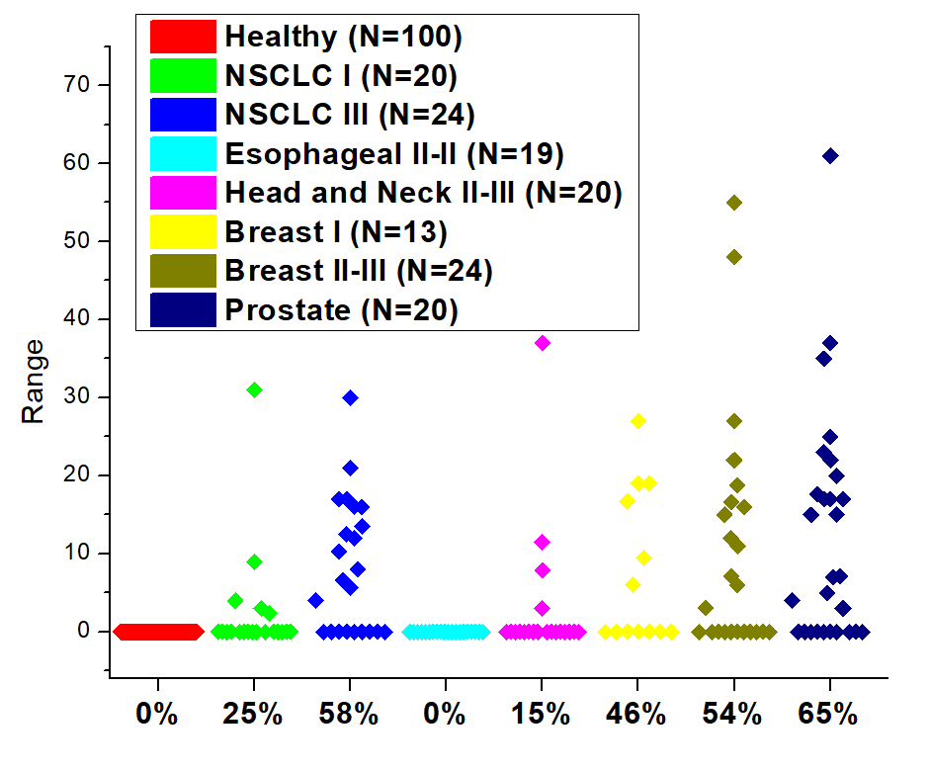
Mir-21 Expression within different cancers

